Slide 1





UNIVERSIDADE FEDERAL DE MINAS GERAIS
INSTITUO DE CIÊNCIAS BIOLÓGICAS
PROGRAMA DE PÓS-GRADUAÇÃO EM BIOINFORMÁTICA
Data integration for curation and comparative genomics
Juliana Assis Geraldo
Notes:
https://github.com/PacificBiosciences/cDNA_primer/wiki/Understanding-PacBio-transcriptome-data
http://www.pacb.com/training/IsoformSequencingIsoSeqOverview/story.html
https://github.com/PacificBiosciences/SMRT-Analysis/wiki/Cannot-import-new-SMRT-Cells
https://s3.amazonaws.com/files.pacb.com/software/smrtanalysis/2.3.0/doc/smrtportal/help/Webhelp/SMRT_Portal.htm
https://s3.amazonaws.com/files.pacb.com/software/instrument/2.0.0/bas.h5+Reference+Guide.pdf

Slide 2
Specific objectives
Build a data stream to evaluate proteins annotation;
RNAseq mapping
TopHat
Re-annotation
De novo gene prediction
Maker2
Local DataBase
InterProScan
Synteny Scoring
SNAP - Augustus
KO
Uniprot
OrthoMCL
BLAST
PacBio (Gmap)

Slide 3
The Challenge of Isoform Reconstruction
Step 1: PACBIO data on RNA for examining current gene calls and boundaries (also Illumina reads)
Schistosoma mansoni
Predicted CDS size: 5,651,633bp
Data:
Genome V5.3 (8chr, mtDNA and 63 unitigs)
Annotated Genome (GFF and Fasta files)
RNAseq reads: Schistosomula - PacBio Reads
Schistosomula - Illumina

Slide 4

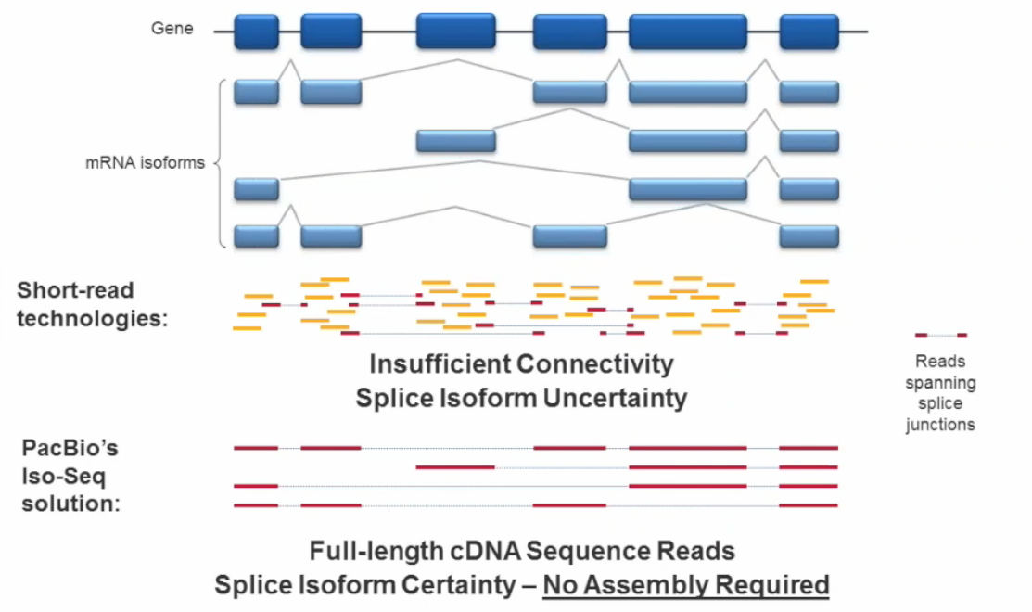

Notes:
Single Molecule, Real-Time (SMRT) Sequencing delivers the long reads needed to capture intact isoform information without assembly or complicated algorithms. The Iso-Seq application identifies transcripts and reveals novel gene isoforms, including gene fusions and full-length mRNA and lncRNA transcripts. You can use the Iso-Seq method to:
Directly sequence full-length transcripts and eliminate the need for transcript reconstruction
Perform broad or targeted surveys of transcript diversity to obtain key information about the frequency and types of alternative transcription
Observe allele-specific gene expression
Differentiate isoform expression between cells, tissues, and disease states

Slide 5
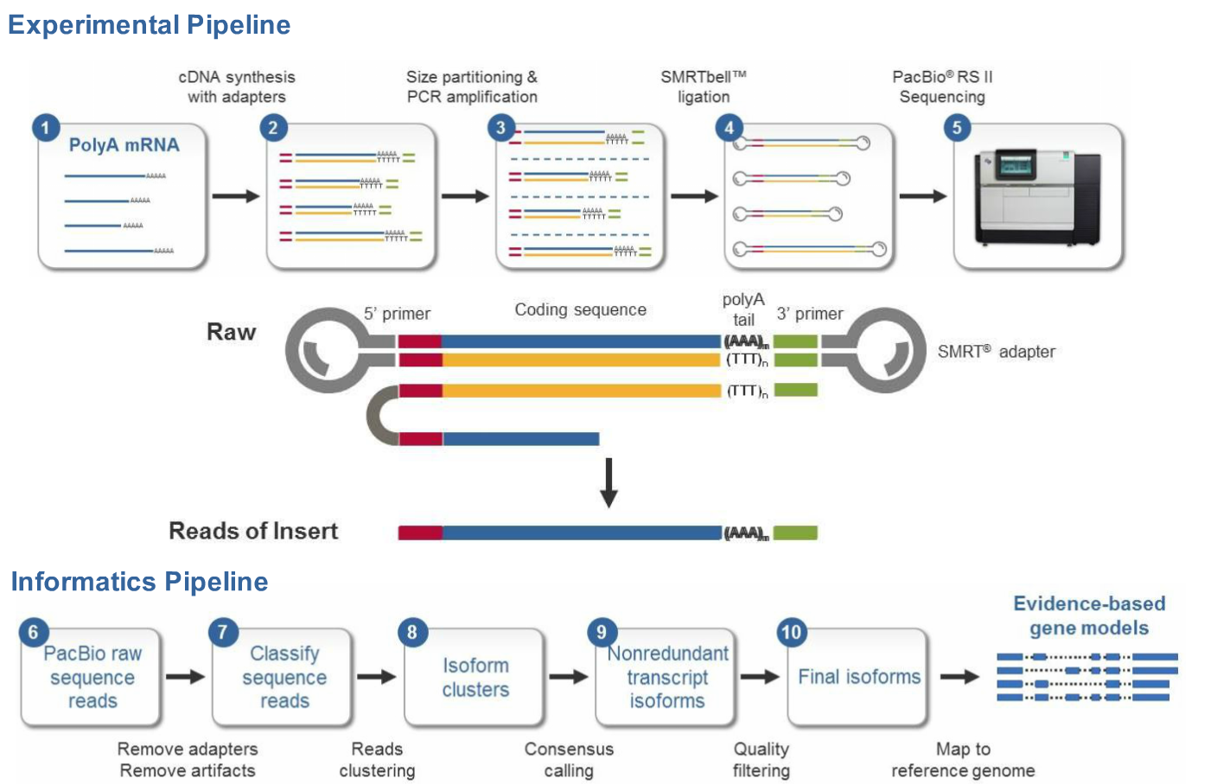
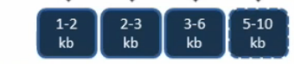
Notes:
PacBio raw sequences reads remove adapters and artifacts, Classify sequences reads (ReadsOfInsert into full-length and non-full-length bins). Isoform cluster (Number of polished high-quality (HQ) isoforms --- This is the number of HQ clusters, each cluster representing a unique isoform. Note that a little redundancy is expected, you may find there are sometimes multiple clusters of the same isoform, which you can collapse using this tutorial. The definition of high-quality versus low-quality is by default set to 99% (determined using Quiver-polished consensus QVs), but can be adjusted by the user during the protocol set up. HQ cluster consensus sequences are what we recommend users to analyze with.) Nonredundant transcripts isoform – consensus calling. Quality filtering (99% accuracy). And the last step is map to reference genome. And we will have the Evidence-based gene models.
https://github.com/PacificBiosciences/cDNA_primer/wiki/RS_IsoSeq-(v2.3)-Interpreting-Classify-and-Cluster-Output
Splicing depende do tipo de tecido ou estágio de vida
O que a pacbio fez para mudar esse cenário
Produce full-length transcripts without assembly
The isoform sequencing (Iso-Seq) application generates full-length cDNA sequences — from the 5’ end of transcripts to the poly-A tail — eliminating the need for transcriptome reconstruction using isoform-inference algorithms.
The Iso-Seq method generates accurate information about alternatively spliced exons and transcriptional start sites.
It also delivers information about poly-adenylation sites for transcripts up to 10 kb in length across the full complement of isoforms within targeted genes or the entire transcriptome.

Slide 6
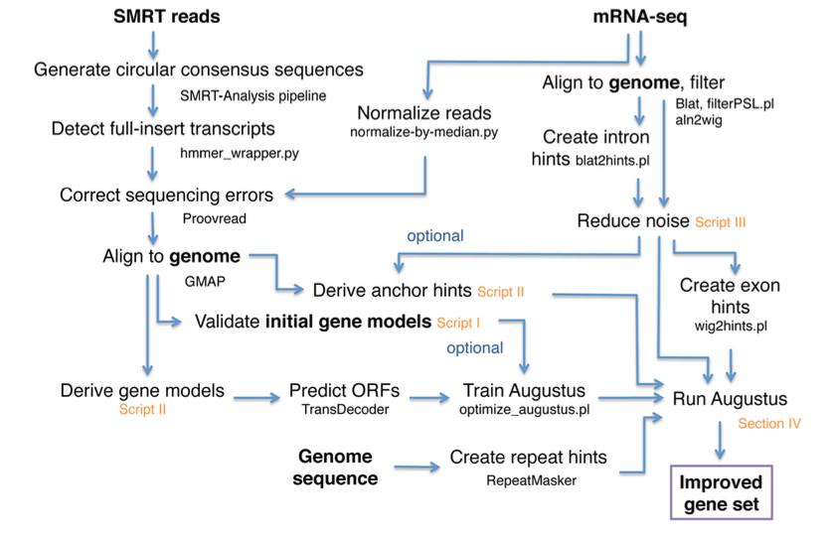
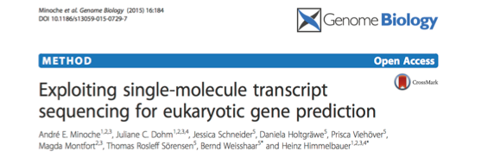
TopHat Bowtie2
*
STAR
Best result
Run Maker2
*
SNAP
Notes:
Correction of SMRT sequences
To determine the sequence accuracy before and after error correction, the sequences were aligned against the set of protein coding gene transcripts. For each SMRT sequence only the best alignment was retained and only if at least 90 % of its length matched.
Legal as ideias, a estrategia, mas eu também pretendo utilizar informacoes de ortólogos para validar exons/introns.
Score.
Gostei muito da quantificacao que eles abordaram.
Illumina mRNA-seq, SMRT, Sanger, and Roche/454 expression data. The number of correct structures was compared between the annotation in RefBeet-1.1 and BeetSet-2.
Devido as taxas de erros fazer esses passos

Slide 7
PacBio
GMAP
STAR
PacBio (Proovread)
GMAP
STAR
Notes:
******I ll change

Slide 8
PacBio Reads
PacBio Pipeline

Slide 9
A cDNA analysis workflow to extract reads of insert from PacBio movies, classify them into chimeric or non-chimeric, full-length or non-full-length reads, and map them to the user-specific reference sequence using GMAP.
</description>
</param>
<param name="flnctobam" label="Convert sam files of full-length non-chimeric reads of insert to bam." hidden="true">
<value>True</value>
<title>Convert sam files of full-length non-chimeric reads of insert to bam</title>
<input type="checkbox"/>
</param>
<param name="ignorePolyA" label="Full-length reads do not require polyA tails">
<value>False</value>
<title>Specify whether or not full-length reads require PolyA tails.</title>
<input type="checkbox"/>
Notes:
Informacao de filtro de qualidade

Slide 10
<param name="gmap_n" label="Maximum number of paths per isoform or read (GMAP --npaths option)">
<value>0</value>
<title>The maximum number of GMAP paths to show for each isoform or read (the same as GMAP --npaths option). If set to 0, print two paths if chimera detected, else one.</title>
<input type="text"/>
<rule type="digits" message="Value must be a non-negative integer"/>
A cDNA analysis workflow to predict de novo consensus isoforms of transcripts from the classified reads using the ICE (Iteratively Clustering and Error Correction) algorithm. Align predicted consensus isoforms to the user-specific reference sequence using GMAP.
</description>
<param name="cluster" label="Predict consensus isoforms using the ICE algorithm">
<value>False</value>
<title>Specify whether or not to predict consensus isoforms using the Iterative Clustering and Error Correction (ICE) algorithm.</title>
<input type="checkbox"/>

Slide 11
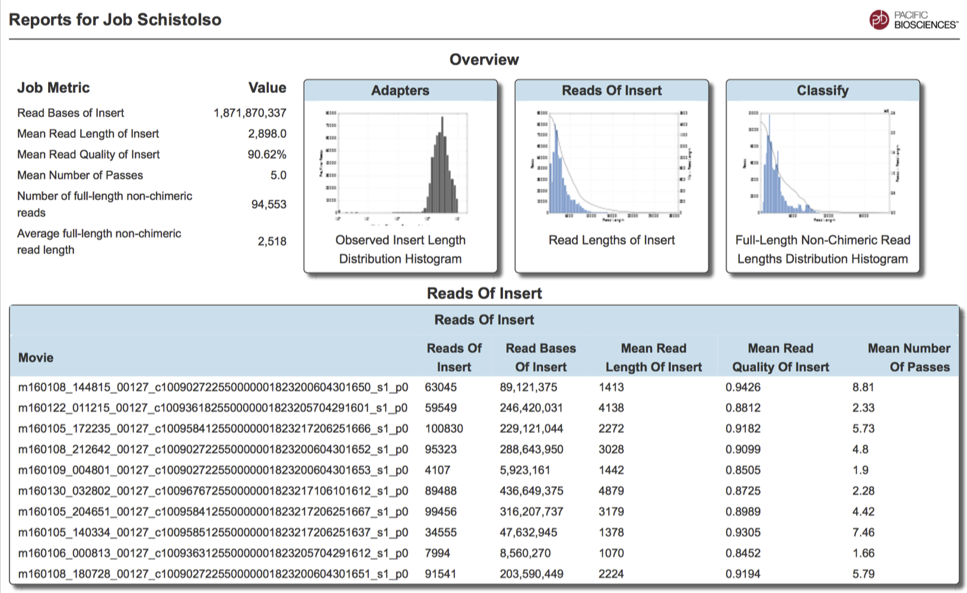
Notes:
the theoretical "fold-coverage" of a shotgun sequencing experiment: number of reads * read length / target size
the theoretical or empirical "breadth-of-coverage" of an assembly: assembly size / target size
the empirical average "depth-of-coverage" of an assembly: number of reads * read length / assembly size
(1) and (3) are not the same because of sequencing error & unclonable/unmappable regions of the genome.

Slide 12
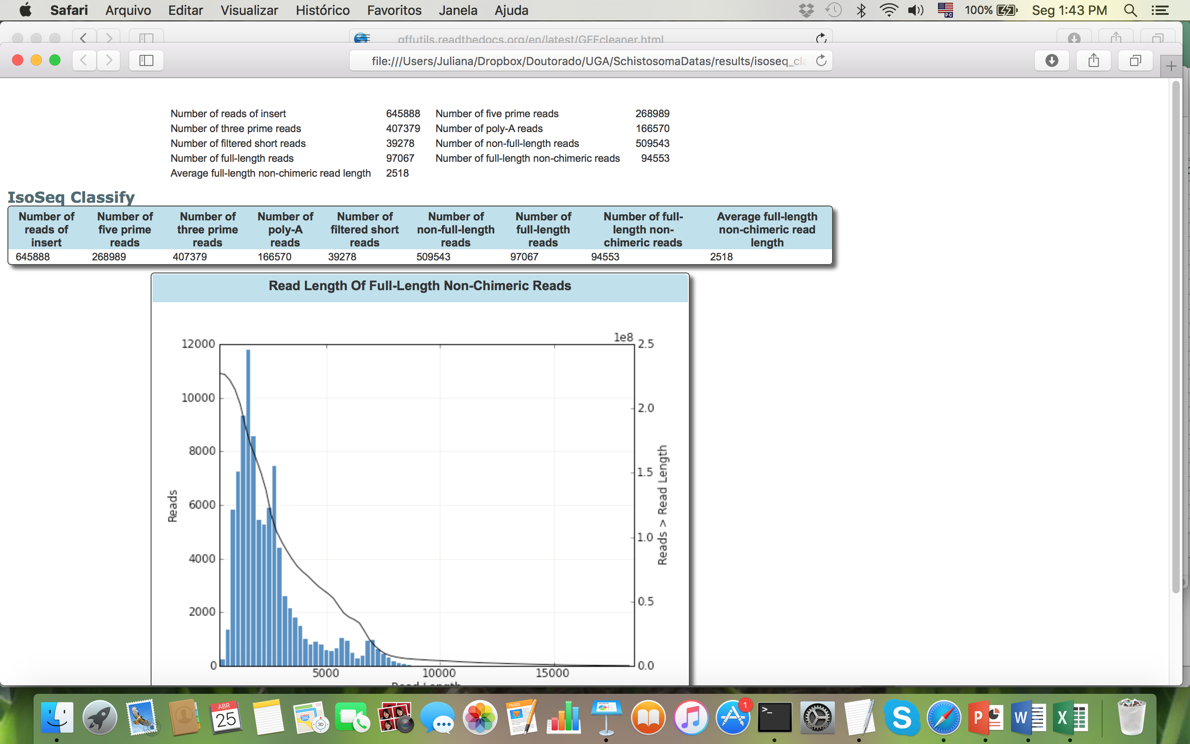
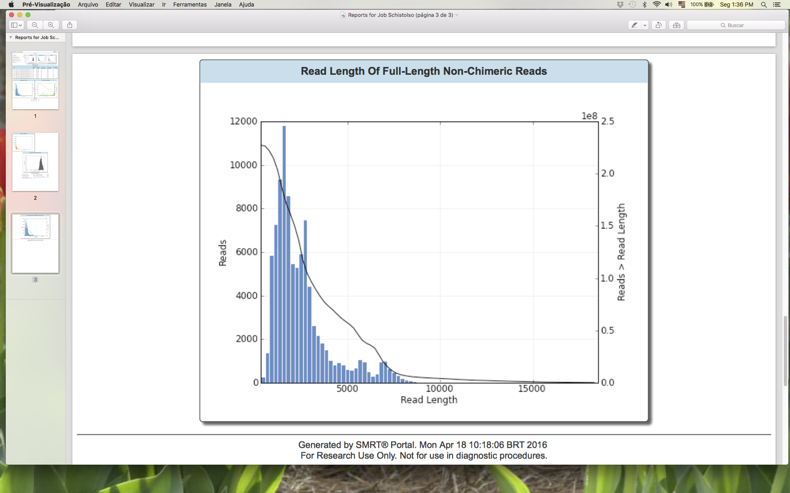
Notes:
Prooveread muda ou nao o nucleotideo?

Slide 13
Illumina Reads
Second Pipeline

Slide 14
Filter Reads – Trimmomatic
java -jar /usr/local/bioinformatica/Trimmomatic-0.33/trimmomatic-0.33.jar PE -threads 20 -phred33 SRR1275508.fastq_1 SRR1275508.fastq_2 SRR1275508.fastq_1_paired.fastq SRR1275508.fastq_1_unpaired.fastq SRR1275508.fastq_2_paired.fastq SRR1275508.fastq_2_unpaired.fastq ILLUMINACLIP:/usr/local/bioinformatica/Trimmomatic-0.33/adapters/TruSeq2-PE.fa:2:40:15 LEADING:30 TRAILING:30 SLIDINGWINDOW:5:20 MINLEN:70 &>logpb
Notes:
Illumina GA 75bp

Slide 15
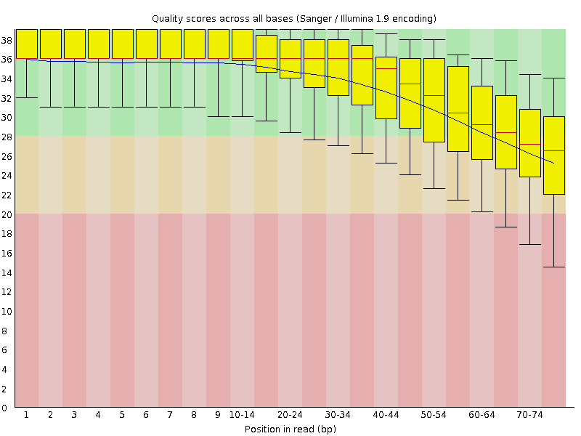
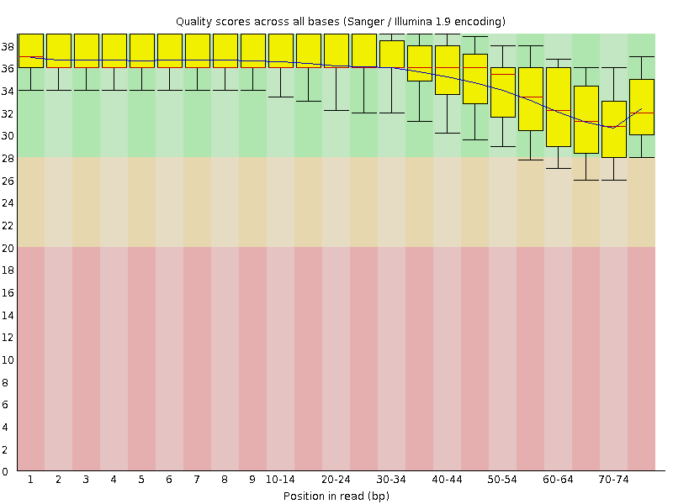
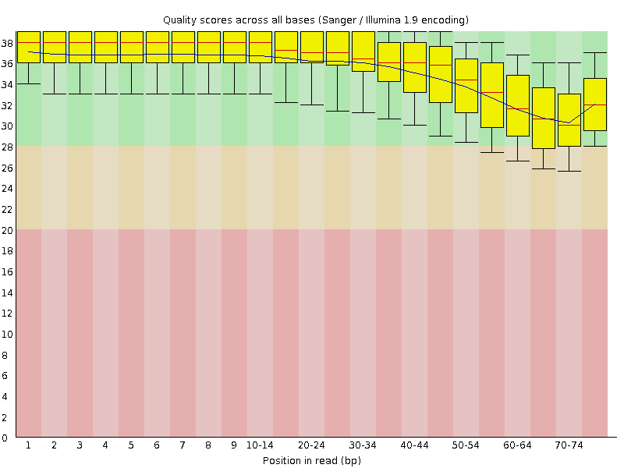

Slide 16
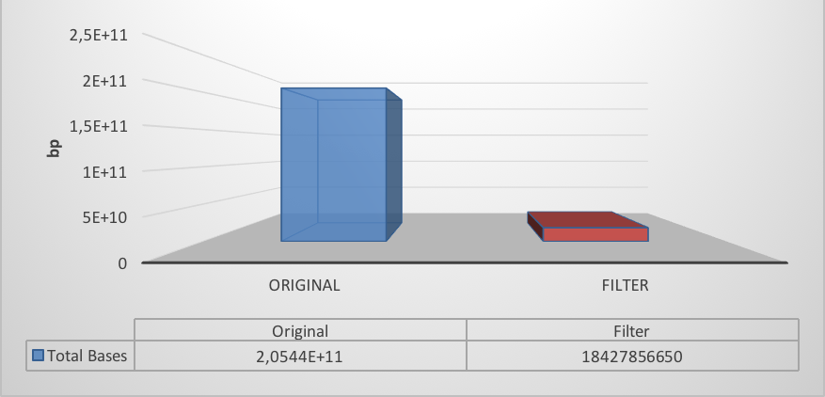
36.79%
Notes:
Calcular porcentagem

Slide 17
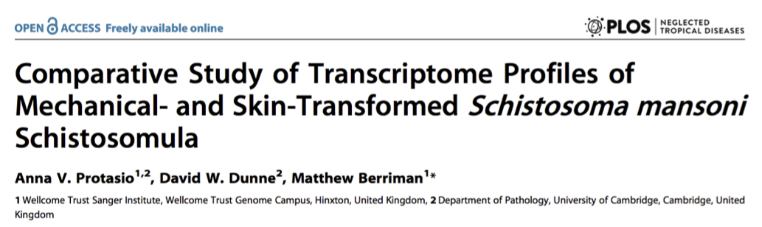
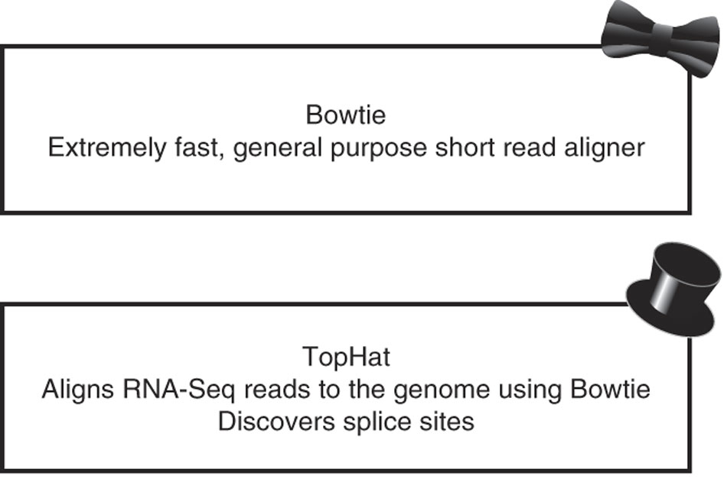
Mapping Reads
RNA-seq reads were aligned to the latest S. mansoni reference genome (version 5.0, [32]) using TopHat [35] (version 1.3.1) with default parameters except for minimum and maximum intron sizes which were set to 10 and 30,000 bp respectively. Other parameters that were specified included the type of library sequenced (set to standard cDNA Illumina library; –library-type fr-unstranded) and the mate pair distance (or insert size; -r option), which was calculated individually for each library. Only uniquely mapping reads were kept for further analyses.
Received August 20, 2012; Accepted January 18, 2013; Published March 14, 2013

Slide 18
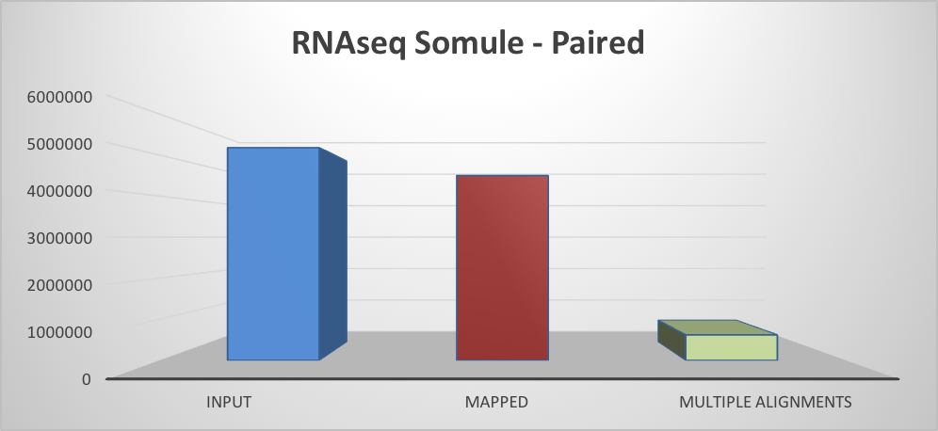
TopHat2 (Bowtie2)
86.9%
14.2%
78.7% concordant pair alignment rate.
Notes:
Number of reads
trabalhar apenas com os 78,7%

Slide 19
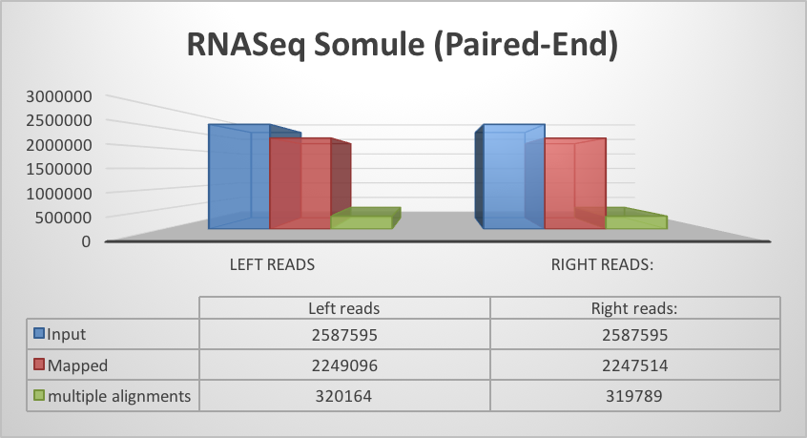
TopHat2 (Bowtie2)

Slide 20
Filter Bam File
samtools merge 2DataSets.bam accepted_hits.bam accepted_hits.bam
samtools view -h -o unfiltered.sam 2DataSets.bam
samtools view -S -bhq 20 -F 0x100 -o accepted_hits_20plus.sam unfiltered.sam
samtools view -S -bhq 50 -F 0x100 -o accepted_hits_50plus.sam unfiltered.sam
-bhq 20 → = -b output Bam, -h print header, -q minimum mapping quality
-F 0x100 → = “secondary alignment”
-f 0x2 → “each segment properly aligned according to the aligner

Slide 21
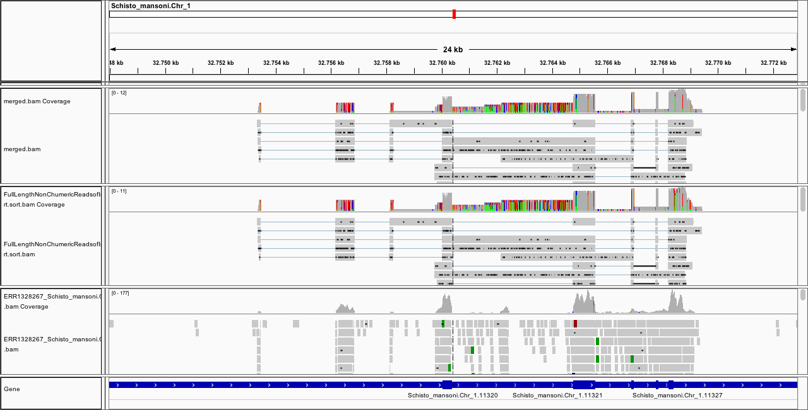

Slide 22
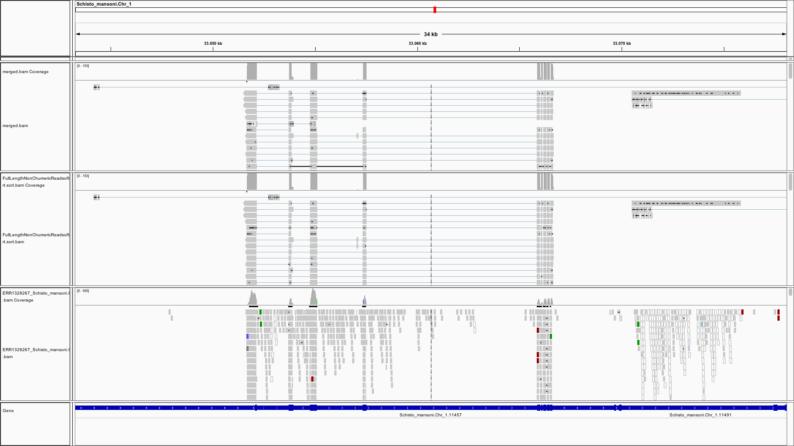

Slide 23
ProovRead
proovread -l ../merged.fasta -s../../NGSIllumina/Trimadas/ERR022883_1_unpaired.fastq ../../NGSIllumina/Trimadas/ERR022883_1_paired.fastq -t 40
Untrimmed reads – Full length
Notes:
Com illumina trimados

Slide 24
Mapping – Full lenght non chimerics reads
 | Input reads | Average read length | Uniquely mapped reads (number) | Uniquely mapped reads (%) | Average mapped length (bp) | Error Rate*
GMAP – PacBio Protocol | 94553 | 2518 | 91324 | 96.58% | 2440 | 3.409985e-02
GMAP - Proovread | 94552 | 2506 | 91582 | 96.85% | 2370 | 2.768500e-02
STAR - Proovread | 94552 | 2506 | 67961 | 71.88% | 2110 | 2.172652e-02
**Nancy | 106137 |  | 102521 | 96.59% | 2329 | 3.344276e-02
**Nancy – GMAP Proovread | 105341 |  | 101836 | 96.67% | 2298 | 3.452523e-02
*Error rate = mismatches / bases mapped (cigar)
** = Bam file
Median coding-protein gene(only CDS) in Schistosoma mansoni = 981bp
Notes:
100012
Calcular a média dos transcritos de schistosoma mansoni
Contar quantas nao mapeadas, extrair o fasta e calcular o restante 981
Eu tenho o consenso de todas e o bed file
https://github.com/PacificBiosciences/cDNA_primer/wiki/Bioinfx-study:-Optimizing-STAR-aligner-for-Iso-Seq-data
Number of contigs 11859
Number of bases in all contigs 5651633
N50 723
Longest contig 7964
Median contig size 327
Number of contigs > 1 kb 1256
Total of bases into contigs > 1 kb 1982108
% contigs> 1 kb 10.591112235433

Slide 26
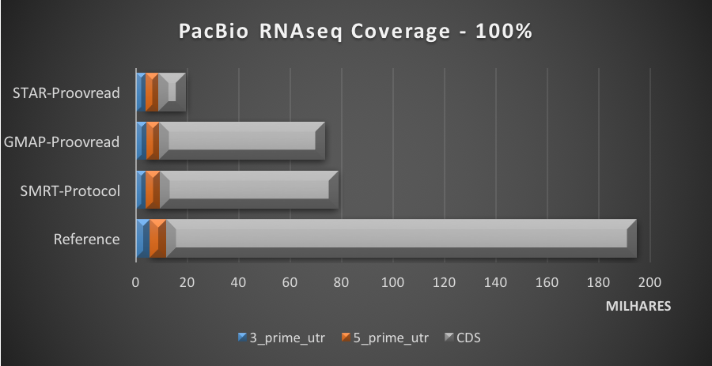
Notes:
Fazer gráfico com 90% e incluir os dados da Nancy
converter bam pra bed, bed coverage usando o gff pra cada regiao

Slide 27
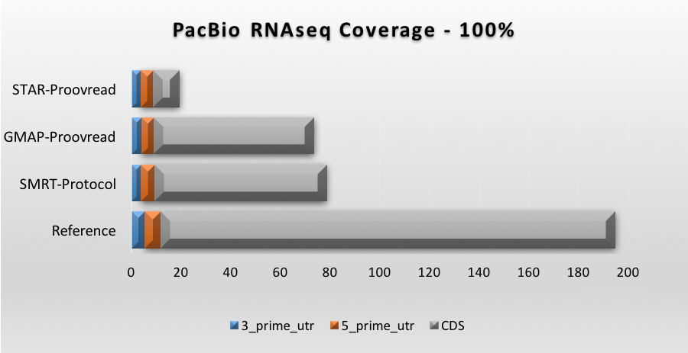
bedtools coverage -a Schistosoma.gff -b pacbio.SMRT.bed > Coverage
Notes:
isso significa concordancia com o genoma

Slide 28
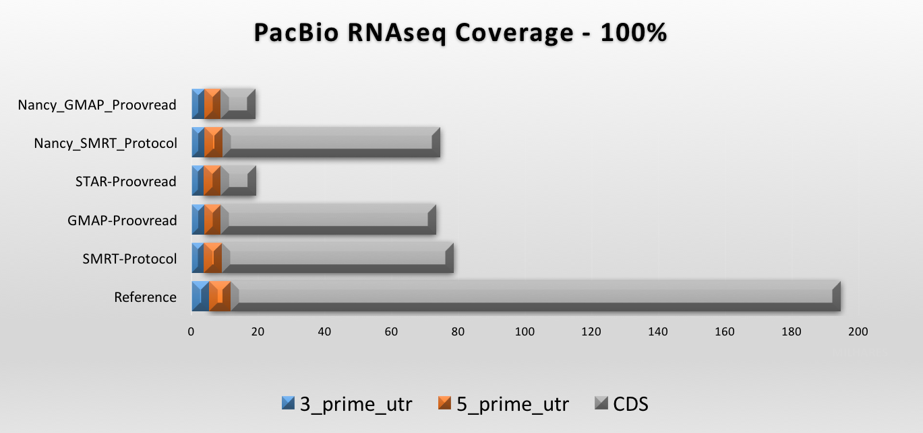

Slide 29
Number of splices: Total| 360536
Number of splices: Annotated (sjdb) | 11052
Number of splices: GT/AG | 340835
Number of splices: GC/AG | 3158
Number of splices: AT/AC | 2708
Number of splices: Non-canonical | 13835
Mismatch rate per base, % | 1.67%
Deletion rate per base | 0.24%
Deletion average length | 1.82
Insertion rate per base | 0.25%
Insertion average length | 2.31
MULTI-MAPPING READS:
Number of reads mapped to multiple loci | 234
% of reads mapped to multiple loci | 0.25%
Number of reads mapped to too many loci | 2
% of reads mapped to too many loci | 0.00%
UNMAPPED READS:
% of reads unmapped: too many mismatches | 0.00%
% of reads unmapped: too short | 15.11%
% of reads unmapped: other | 12.76%
CHIMERIC READS:
Number of chimeric reads | 0
% of chimeric reads | 0.00%
Notes:
Qual o numero de splicing em schistosoma (atual)

Slide 30
Transcriptome Assembly Quality Assessment
Examine the RNA-Seq read representation of the assembly. Ideally, at least ~80% of your input RNA-Seq reads are represented by your transcriptome assembly.
Examine the representation of full-length reconstructed protein-coding genes, by searching the assembled transcripts against a database of known protein sequences.
Use BUSCO to explore completeness according to conserved ortholog content.
Compute the E90N50 transcript contig length - the contig N50 value based on the set of transcripts representing 90% of the expression data.
Compute DETONATE scores. DETONATE provides a rigorous computational assessment of the quality of a transcriptome assembly.
Notes:
https://github.com/trinityrnaseq/trinityrnaseq/wiki/Transcriptome-Assembly-Quality-Assessment
$TRINITY_HOME/util/SAM_nameSorted_to_uniq_count_stats.pl bowtie_out/bowtie_out.nameSorted.bam
#read_type count pct
proper_pairs 23383 79.62
improper_pairs 3676 12.52 (left and right reads align, but to different contigs due to fragmentation)
left_only 1199 4.08
right_only 1112 3.79
Total aligned rnaseq fragments: 29370

Slide 31
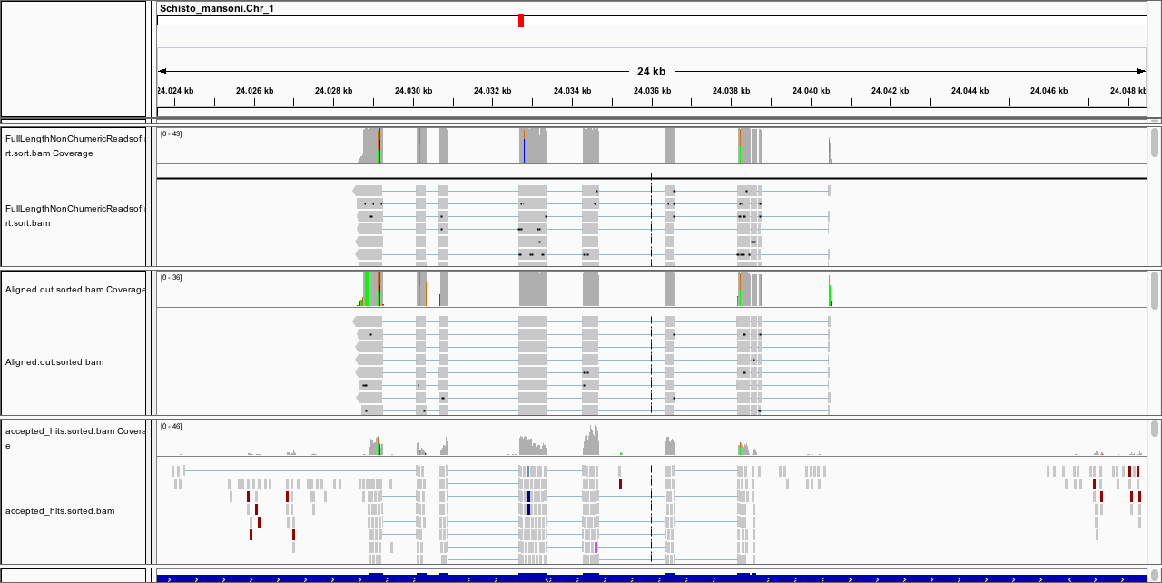

Slide 32
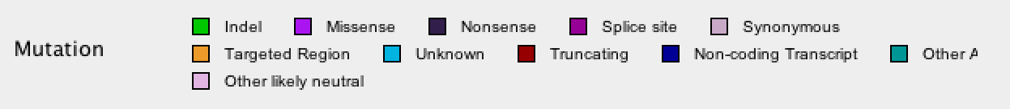

Slide 33
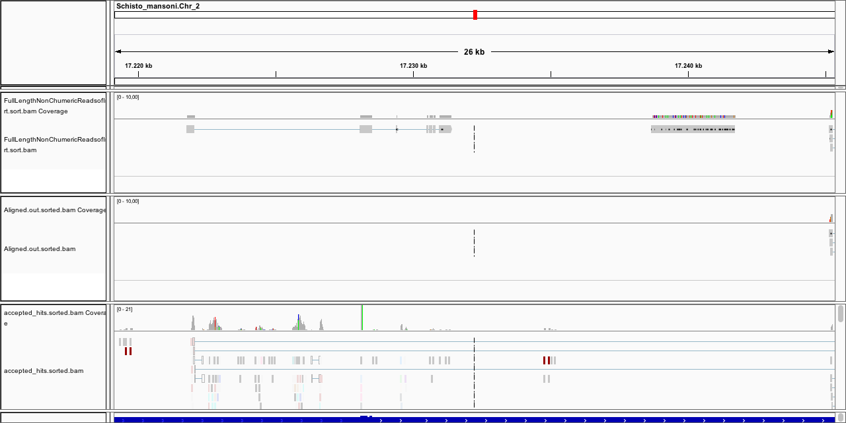

Slide 34
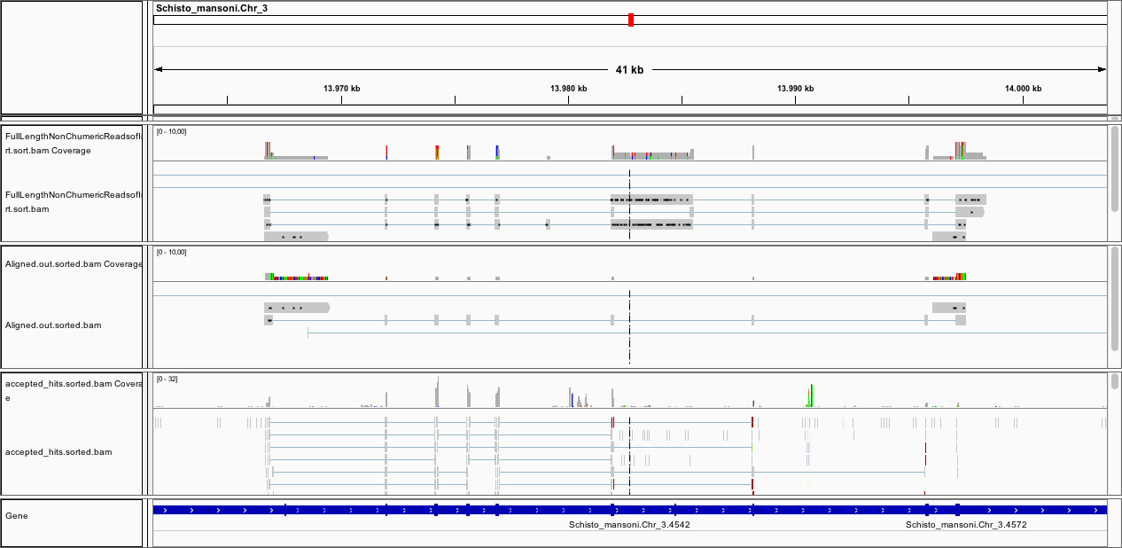

Slide 35
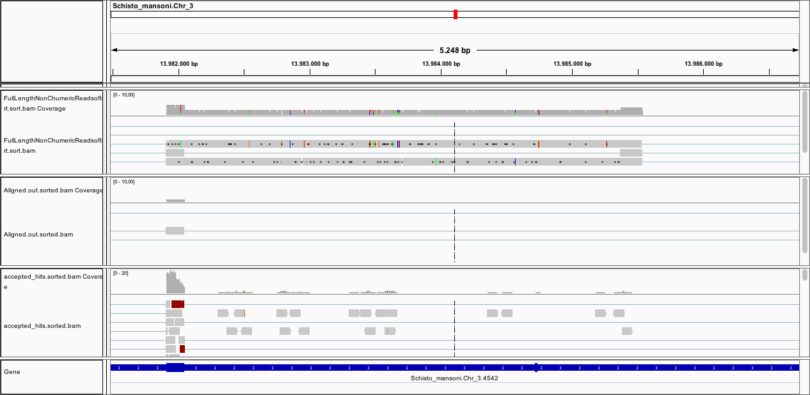

Slide 36
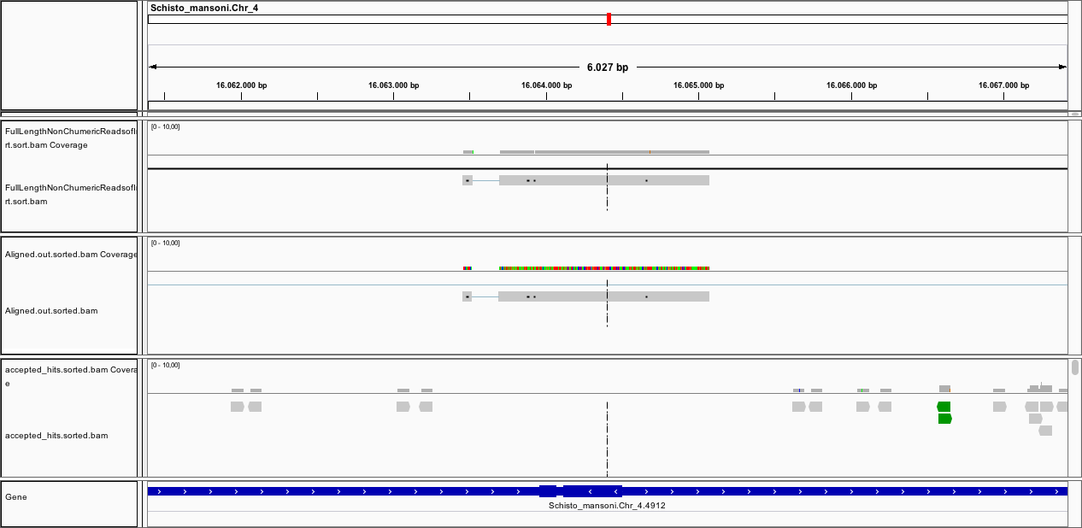

Slide 37
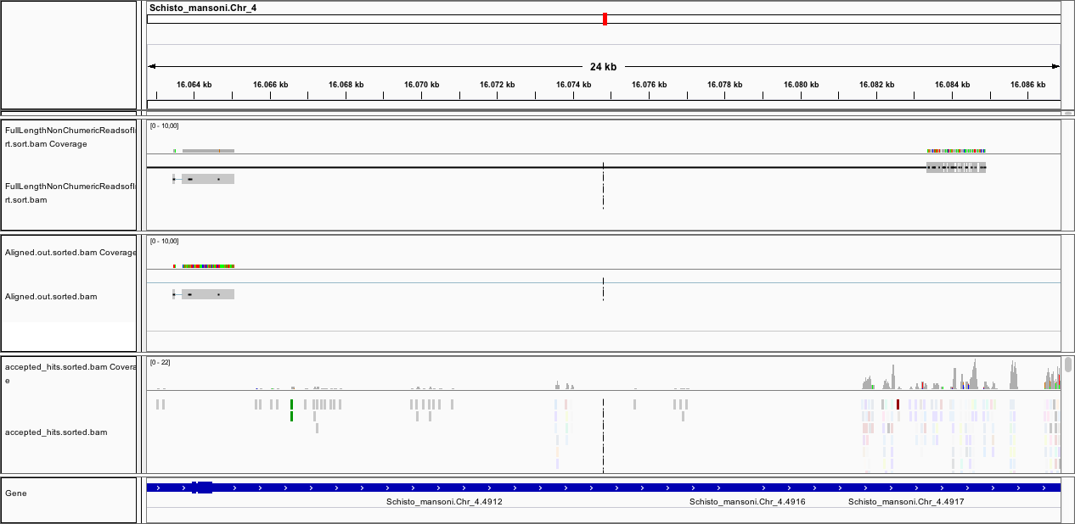

Slide 38
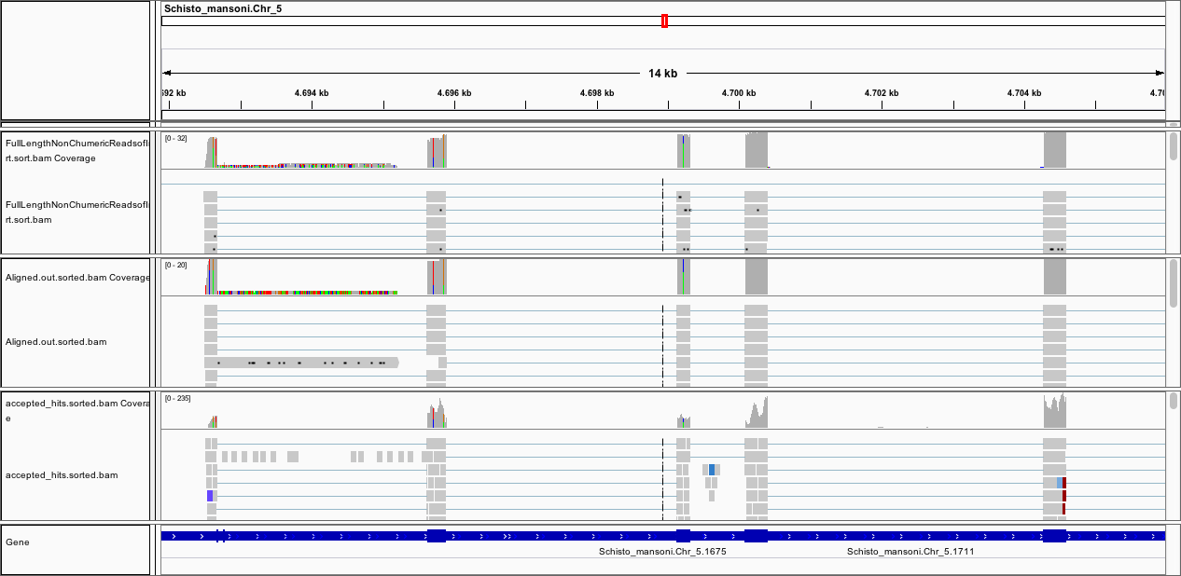
Notes:
perfect

Slide 39
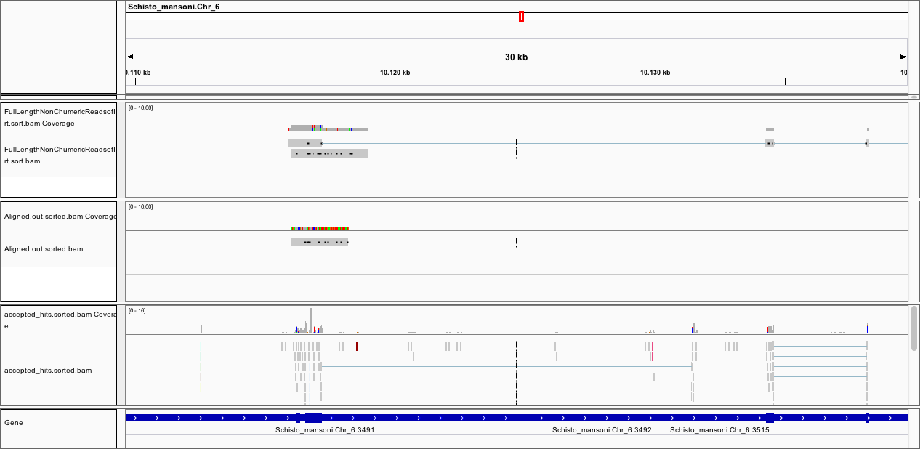

Slide 40
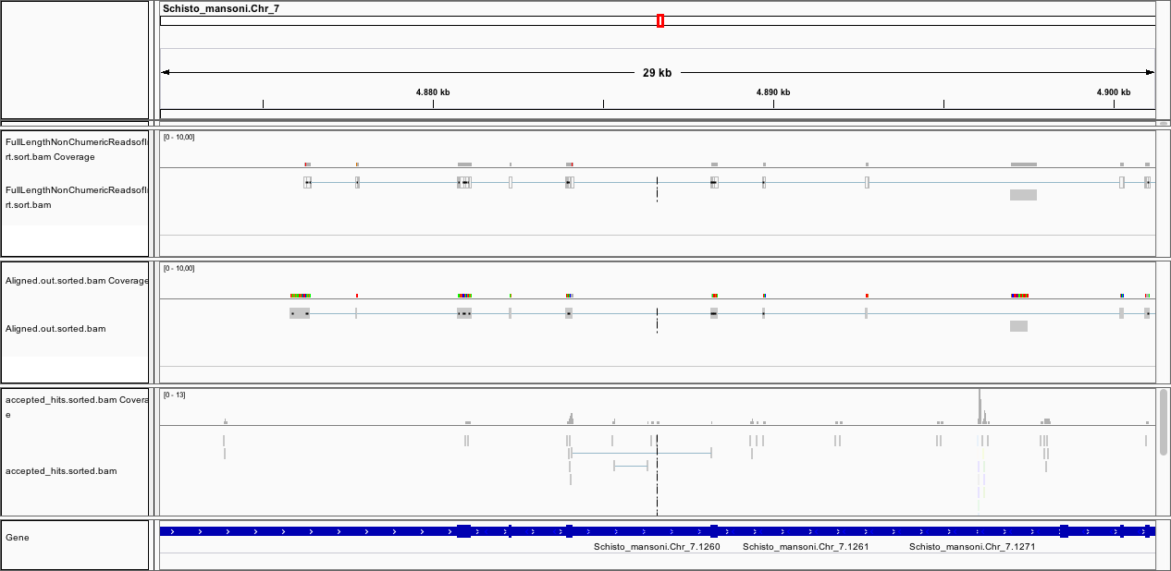

Slide 41
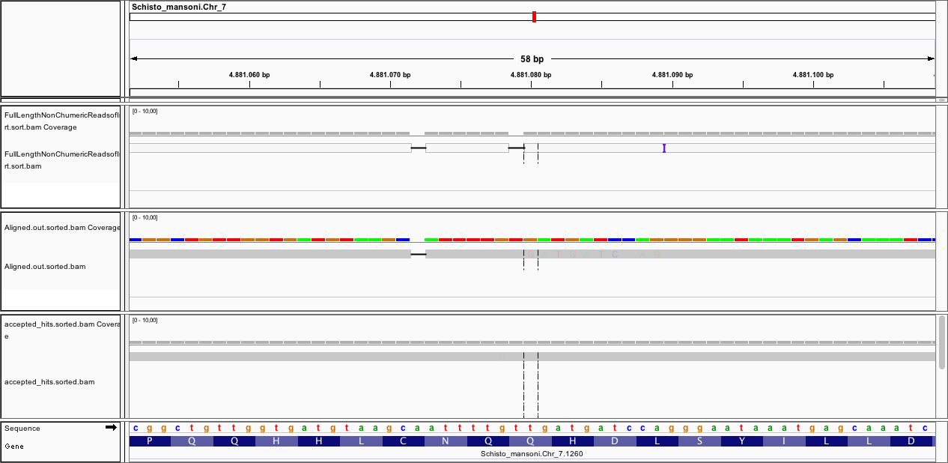

Slide 42
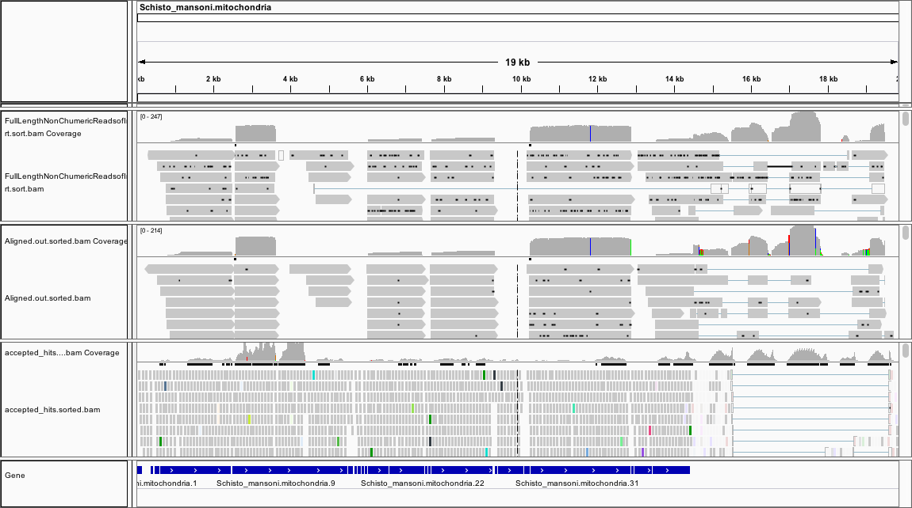

Slide 43
PacBio
Proovread
GMAP
STAR
PacBio
PacBio
Full length no chimera
Illumina
Data Integration
Only PacBio Data
Consensus
The largest
Present
Notes:
Problemas e Solucoes
validacao do pacbio – ainda tenho que integrar com o illumina
Atribuir score = quem seria o mais importante?
Posso mapear as reads pacbio com o STAR

Slide 44
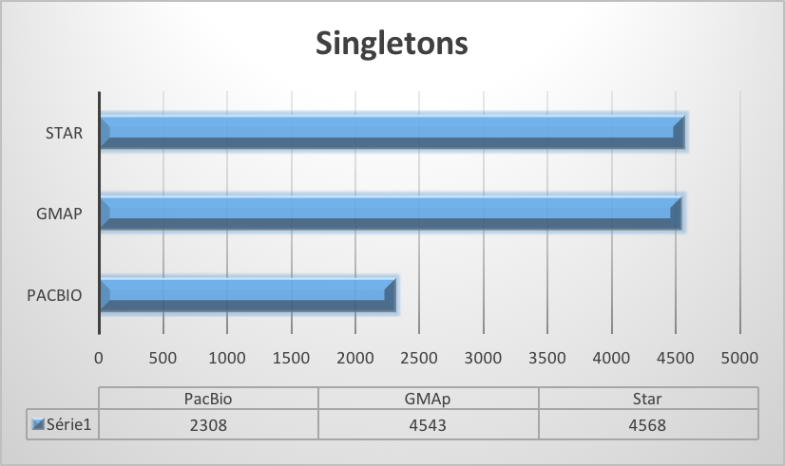
BedTools multiIntersectBed
Chrom | Start | End | Num | List | P | G | S
Schisto_mansoni.Chr_6 | 710249 | 717695 | 1 | G | 0 | 1 | 0
Schisto_mansoni.Chr_6 | 717695 | 727516 | 3 | P,G,S | 1 | 1 | 1
Schisto_mansoni.Chr_6 | 727516 | 756118 | 1 | G | 0 | 1 | 0
Schisto_mansoni.Chr_6 | 756118 | 787617 | 3 | P,G,S | 1 | 1 | 1
Schisto_mansoni.Chr_6 | 787617 | 791605 | 1 | G | 0 | 1 | 0
Schisto_mansoni.Chr_6 | 791605 | 819761 | 3 | P,G,S | 1 | 1 | 1
Schisto_mansoni.Chr_6 | 819761 | 819767 | 2 | P,G | 1 | 1 | 0
3 = Concordance 3 ------ > ok
2 = Concordance 2 ------ > ok
1 = Singleton 1
P = PacBio
G = Gmap PacBio Prooveread
S = Star PacBio Proovread
Notes:
Incluir os resultados da Nancy
17142 Total
388 Concordantes3
5335 Concordantes2
11419 Singletons1
Analisando o 1 em relacao a quantidade de bases:
1 base de diferença = 78
2 bases = 48
3 bases = 48 ...
Media e Mediana da diferença
10287 MED
30841 MEDIA
é bem grande.
A quantidade de "posições mapeadas" únicas por programa
Gmap = 4543
PacBio = 2308
Star = 4568

Slide 45
Step 2: Re-annotation
RNASeq data = Illumina and PacBio
ESTs = Sanger
Notes:
desafio é que to comparando posicao, e pode ter diferenca de sequencia

